Slide 1
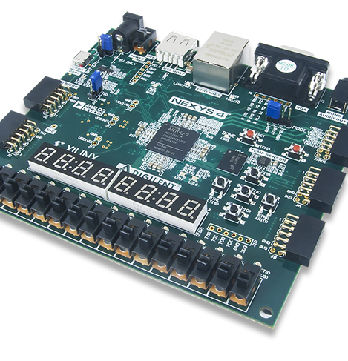
Lab 7
Group_D:
Laurice Sattouf
Choi Tim Anthony Young
Dimitri Garcia
Professor:
Mohamed El-Hadedy
California Polytechnic State University Pomona, California

Slide 2
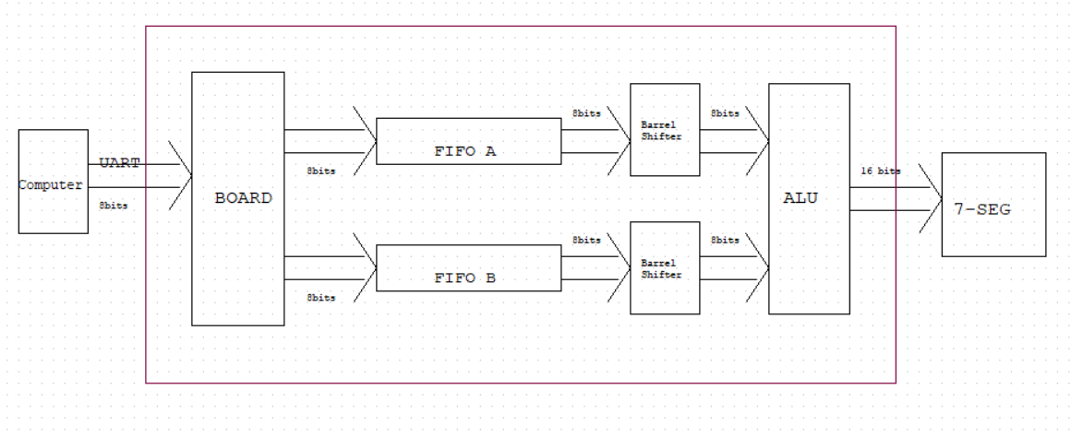
Assignment
Design a system that take the data from the computer into the board using the UART communication protocol(Async). The data will be distributed into two different ports, FIFO-A and FIFO-B, and each output of these ports will be connected to the Barrel shifter. The output of the barrel shifters will be 2 inputs to the ALU to make all the operations needed, Arithmetic for now. The output will be 16 bit displayed on 7-segment display.

Slide 3
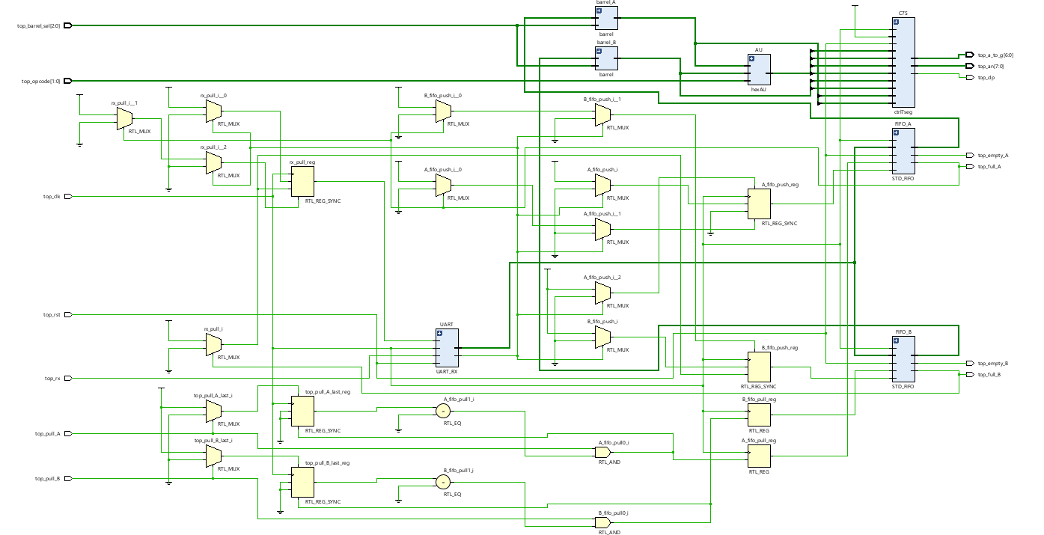
Schematic

Slide 4
Power and Resources

Slide 5
Difficulties
We have verified all the codes that we created for this lab, and all of the steps and the logic makes sense, but there is an error that we couldn’t figure out.

Slide 6

Work Distribution
We had a meeting to brainstorm and explain the main idea of the lab, and we created the schematic so that everyone would work individually to achieve the most optimized design.
Documentation and reports were evenly distributed, and it covered all the steps of our successfully implemented design.

